Slide 1

Simulation and Hardware Implementation of BPSK Modulation and Demodulation​​
Submitted By: Group 5​
Instructor: Md Nure Alam Dipu​
Course: Communication Laboratory (EEE 3308)
​Institution: United International University​

Slide 2
Group Members:
1. Zarin Tasnim -021 181 094
2. Azad Hossain Saykat - 021 221 017
4. Suvom Karmakar - 021 221 027
3. Sazzad Hossen - 021 221 026
5. Umama Binte Rahim - 021 221 093

Slide 3
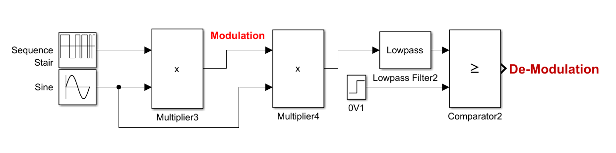
Introduction
BPSK Modulation: Binary Phase Shift Keying (BPSK) is a digital modulation technique where the phase of a carrier signal is shifted between two distinct values (0° and 180°) to represent binary data (0 and 1).
BPSK Demodulation:
The modulated signal is multiplied with a synchronized reference carrier, filtered to extract the baseband signal, and processed by a comparator to recover the original binary data.

Slide 4
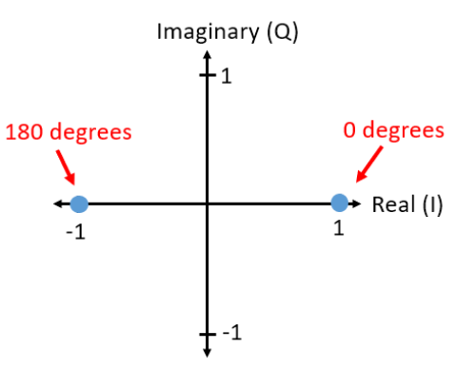
Why BPSK?
BPSK is the simplest digital modulation scheme.
With only two distinct phase states (0° and 180°),
BPSK is highly resistant to noise.
BPSK requires less power compared to higher-order
modulation schemes.
It widely used in wireless communications,
satellite links, and other systems.

Slide 5
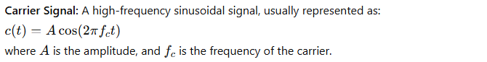
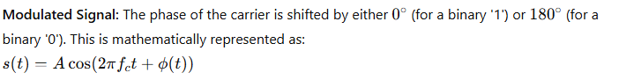

Mathematical overview
BPSK Modulation:

Slide 6
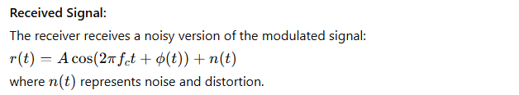
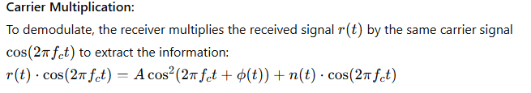
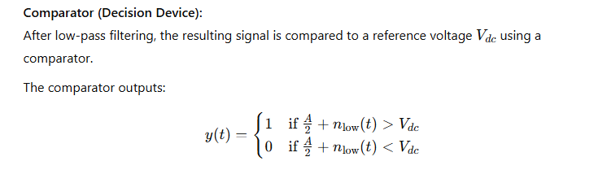
Mathematical overview
BPSK Demodulation:

Slide 7
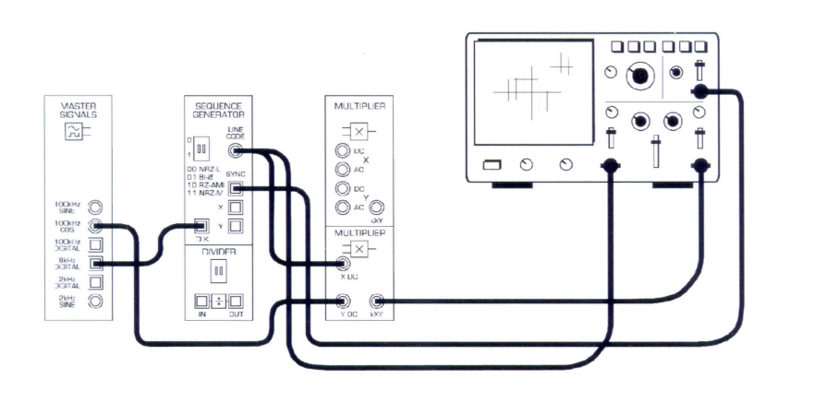
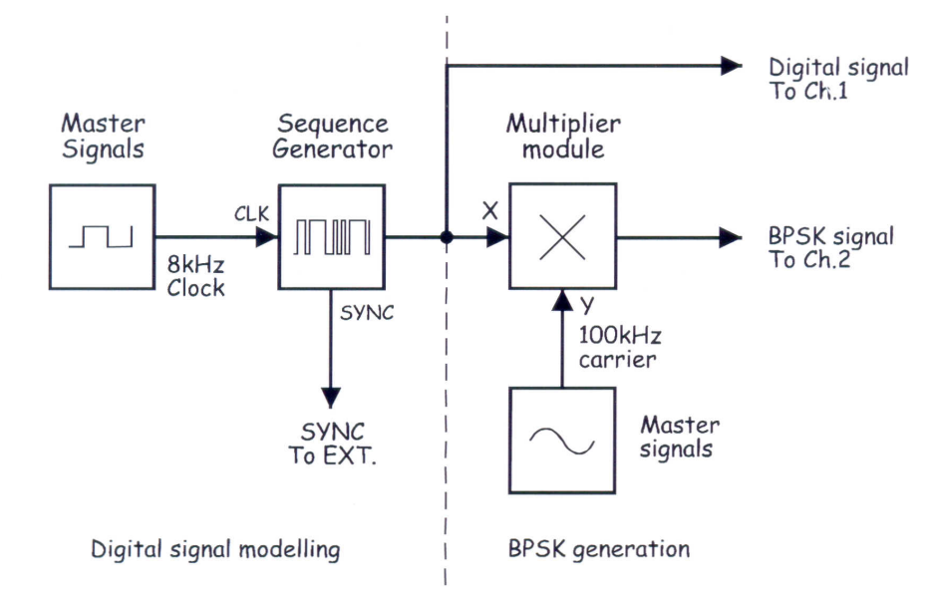
Working Methodology of BPSK Part A – Generating a BPSK Signal: Circuit Diagram and Block Diagram

Slide 8
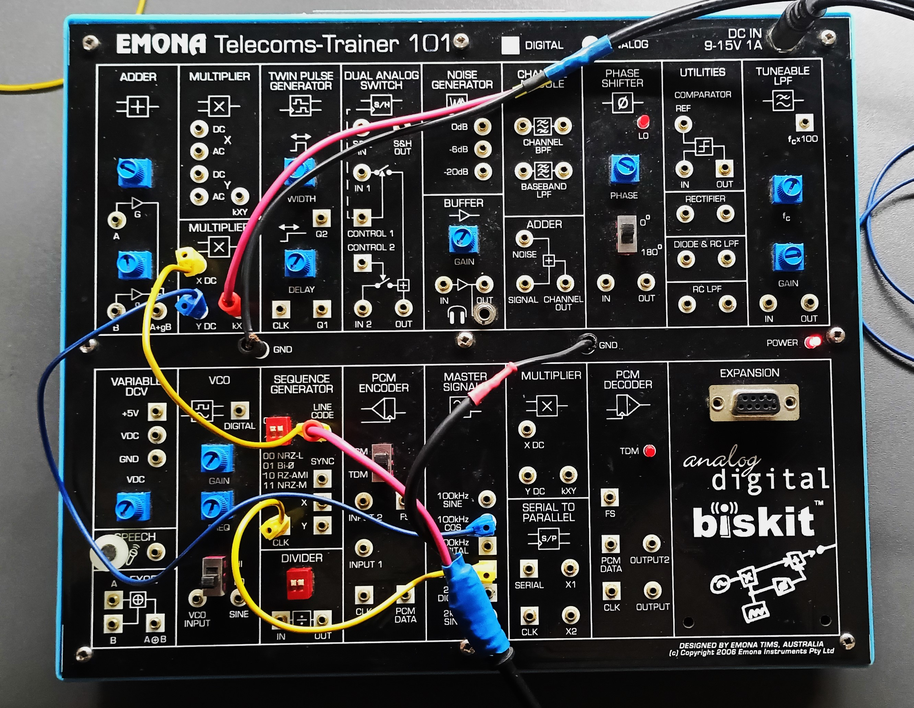
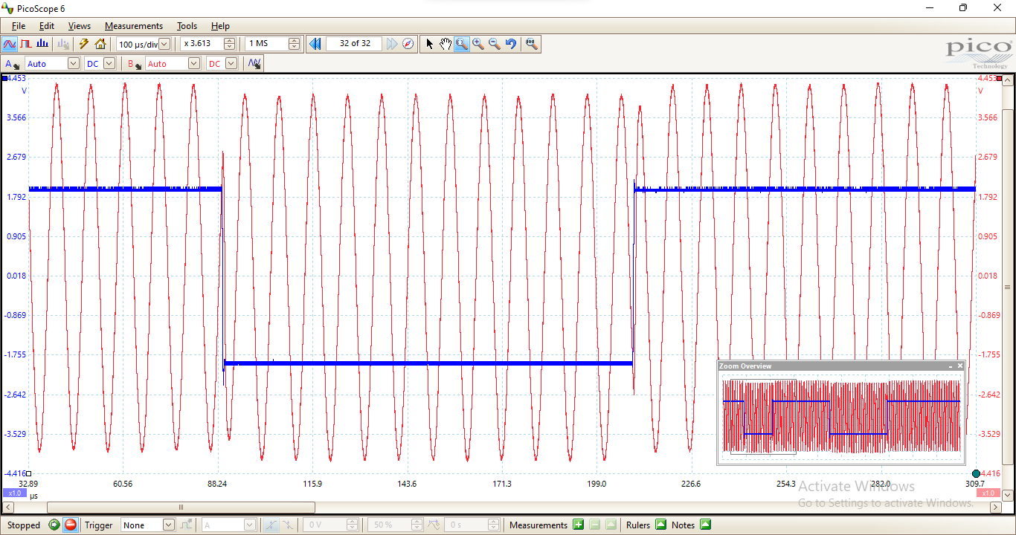
Working Methodology of BPSK Part A – Generating a BPSK Signal: Emona Board Implementation and Pico-scope Output

Slide 9
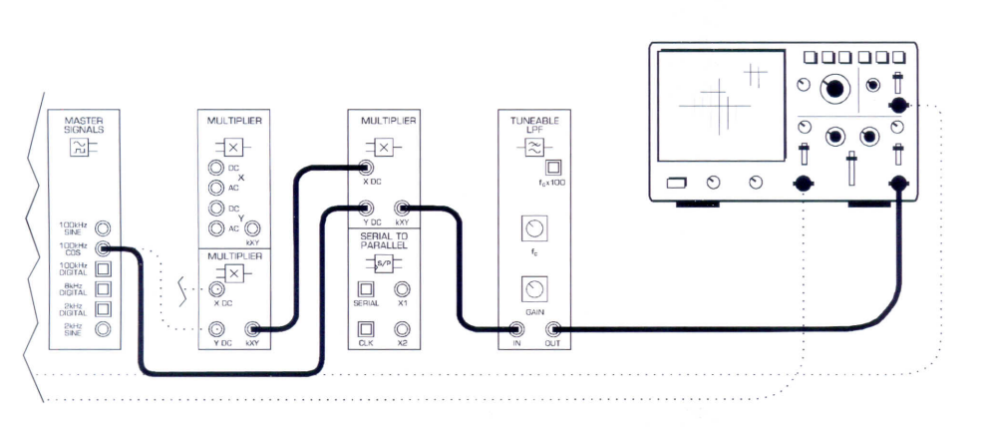
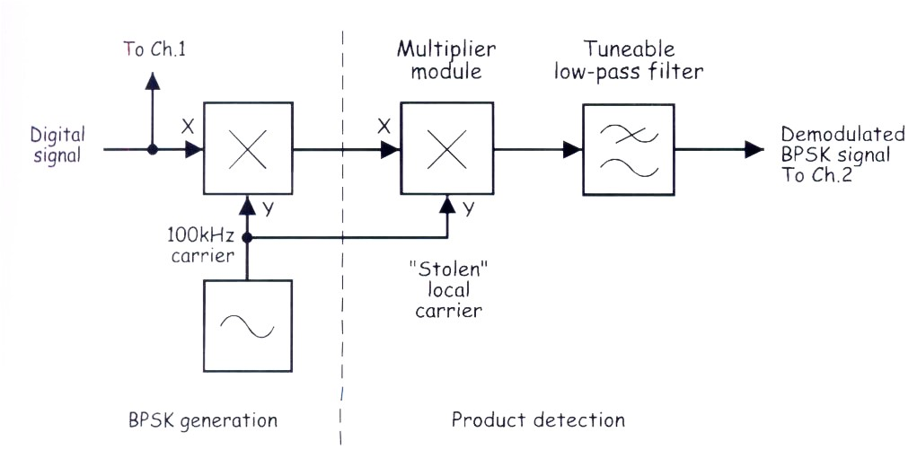
Working Methodology of BPSK
Part B- Demodulating a BPSK Signal using a Product Detector: Circuit and Block Diagram

Slide 10
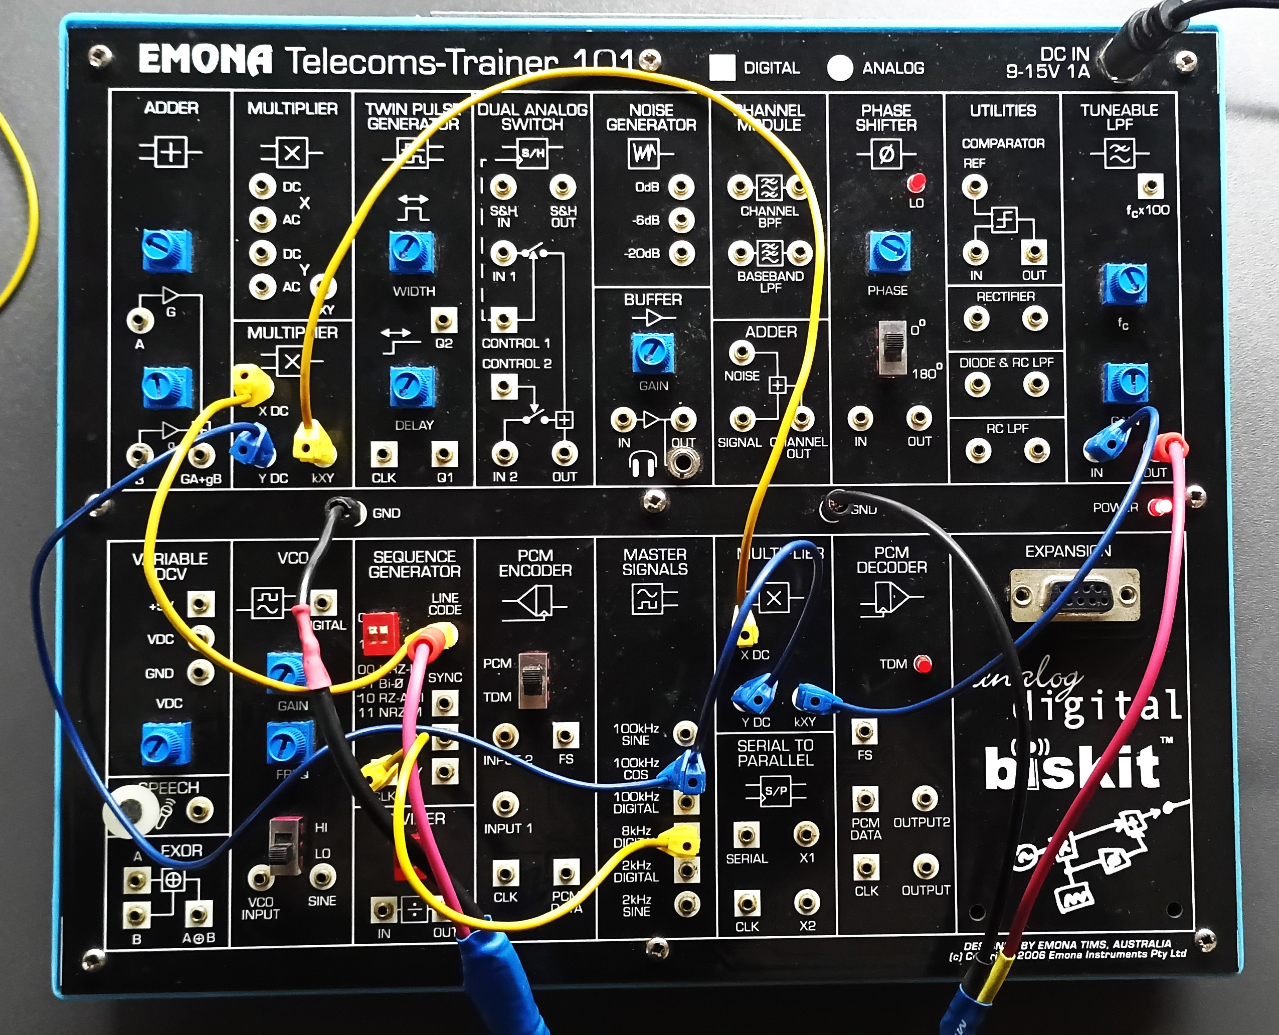
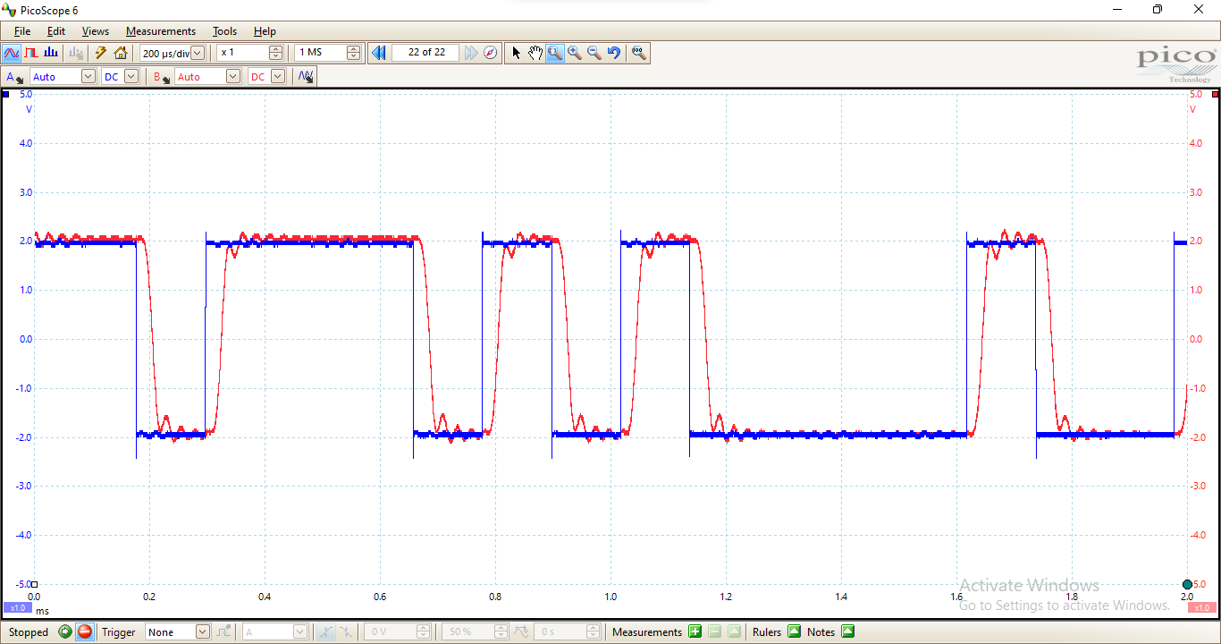
Working Methodology of BPSK
Part B- Demodulating a BPSK Signal using a Product Detector:
Emona Board Implementation and Pico-scope Output

Slide 11
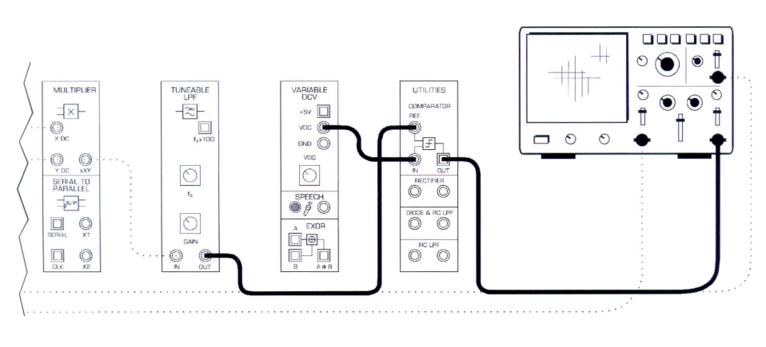
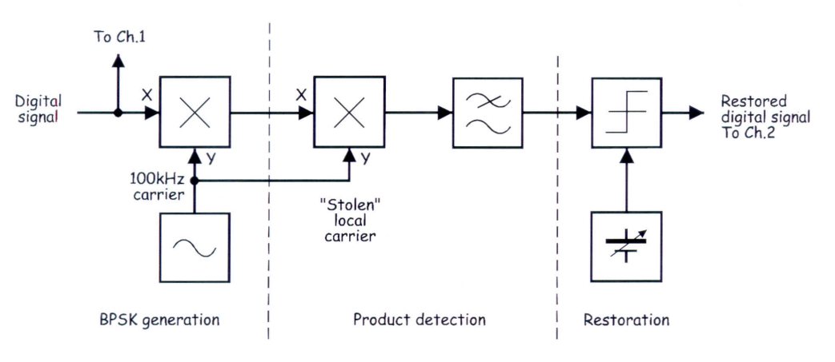
Working Methodology of BPSK
Part C- Restoring the Recovered Data using a Comparator: Circuit and Block Diagram

Slide 12
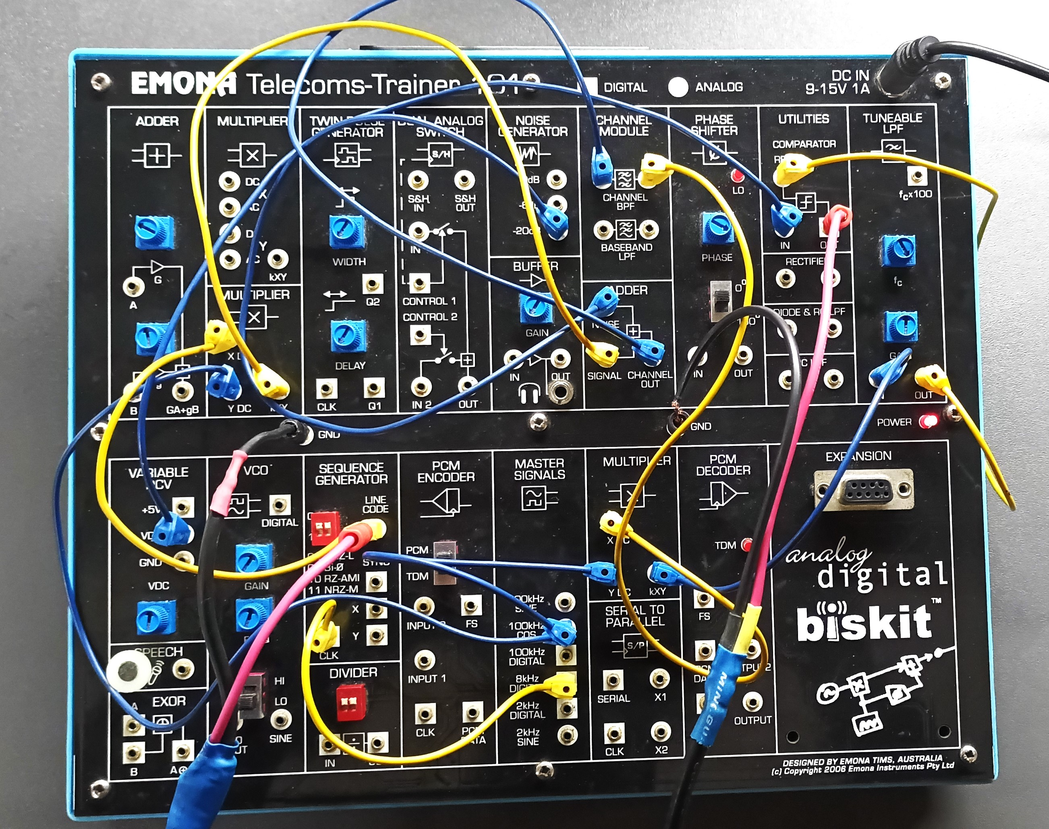
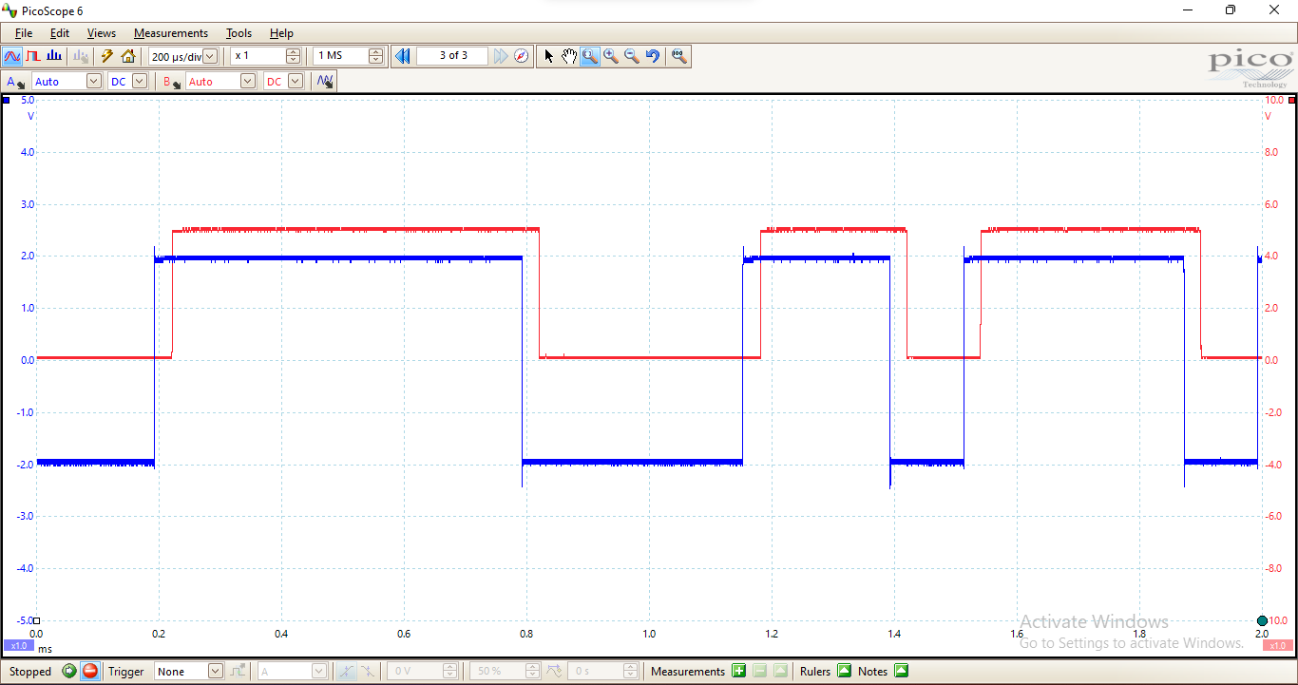
Working Methodology of BPSK
Part C- Restoring the Recovered Data using a Comparator: Emona Board Implementation and
Pico-scope Output

Slide 13
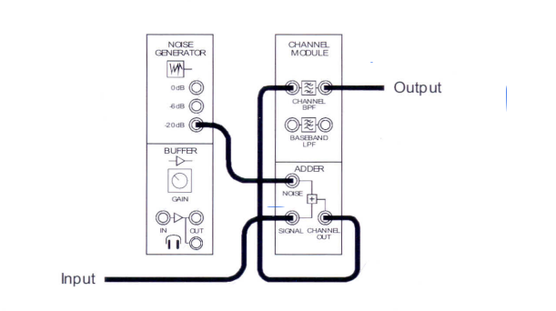
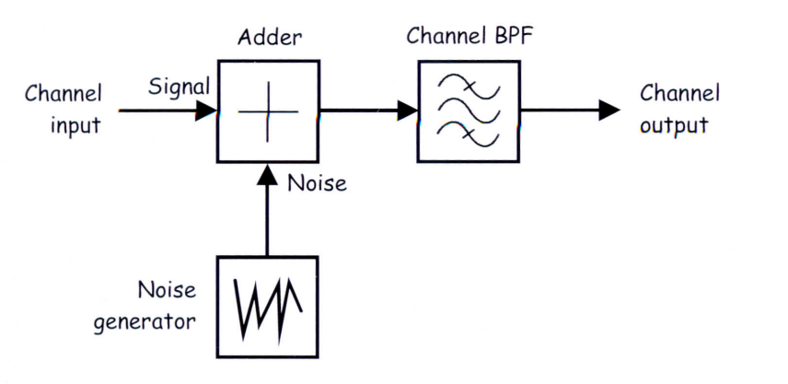
Working Methodology of BPSK
Part D- Adding Noise to Transmitted Signal: Circuit and Block Diagram

Slide 14
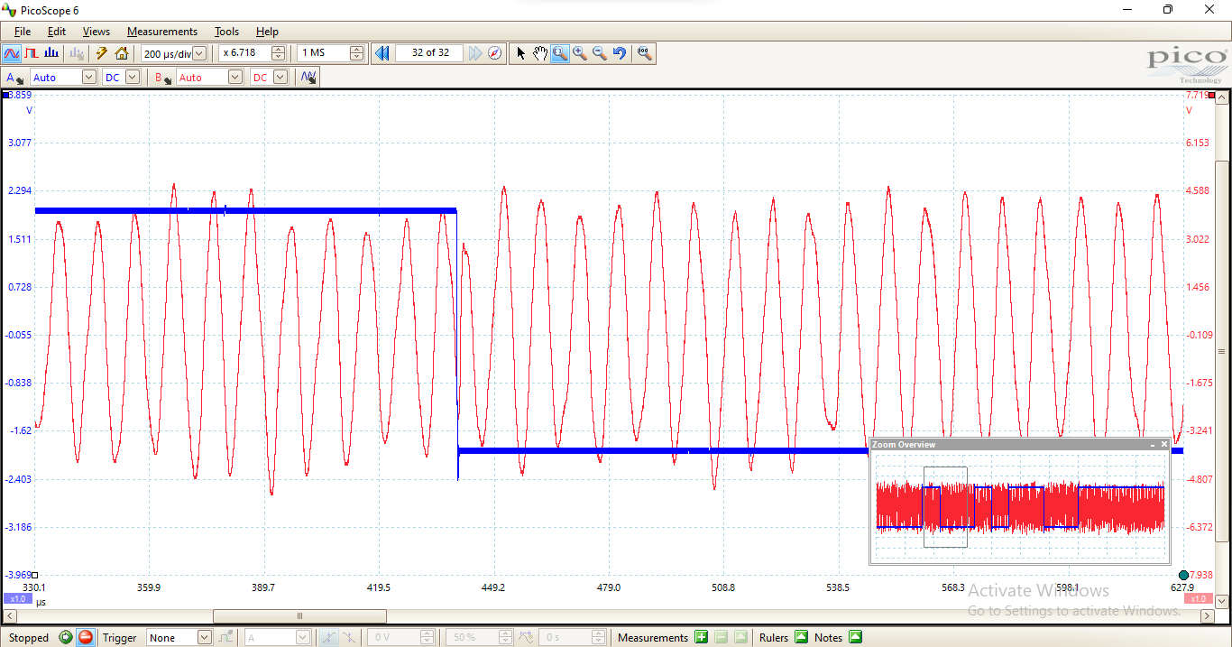
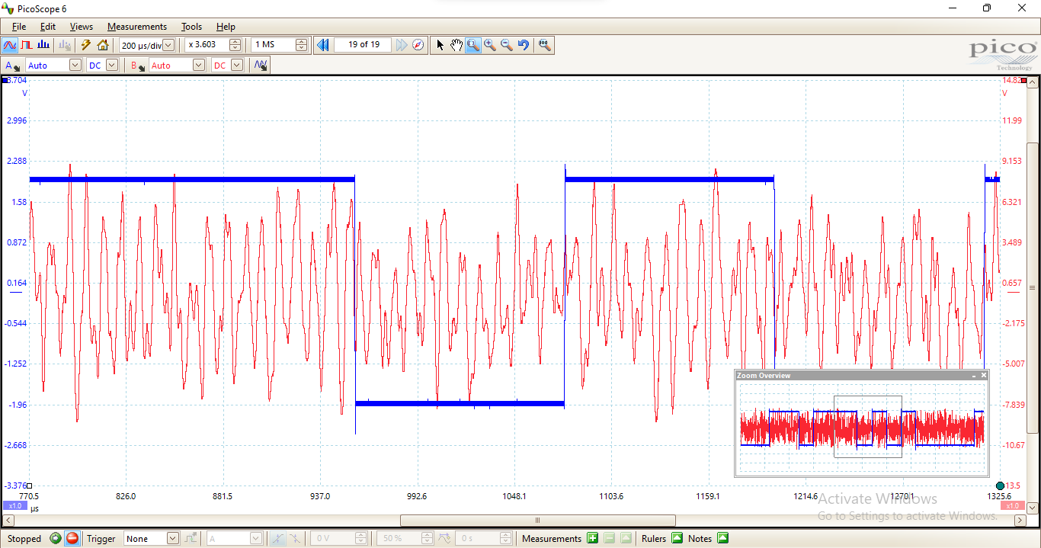
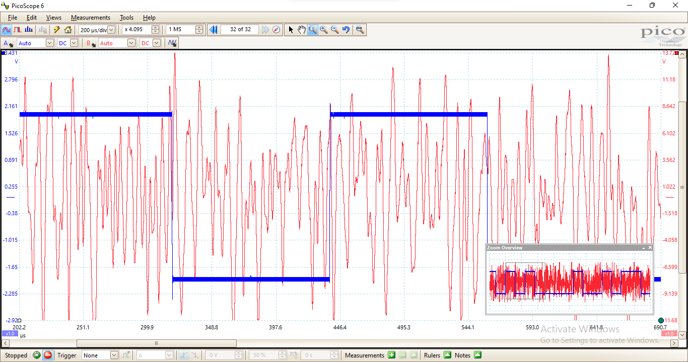
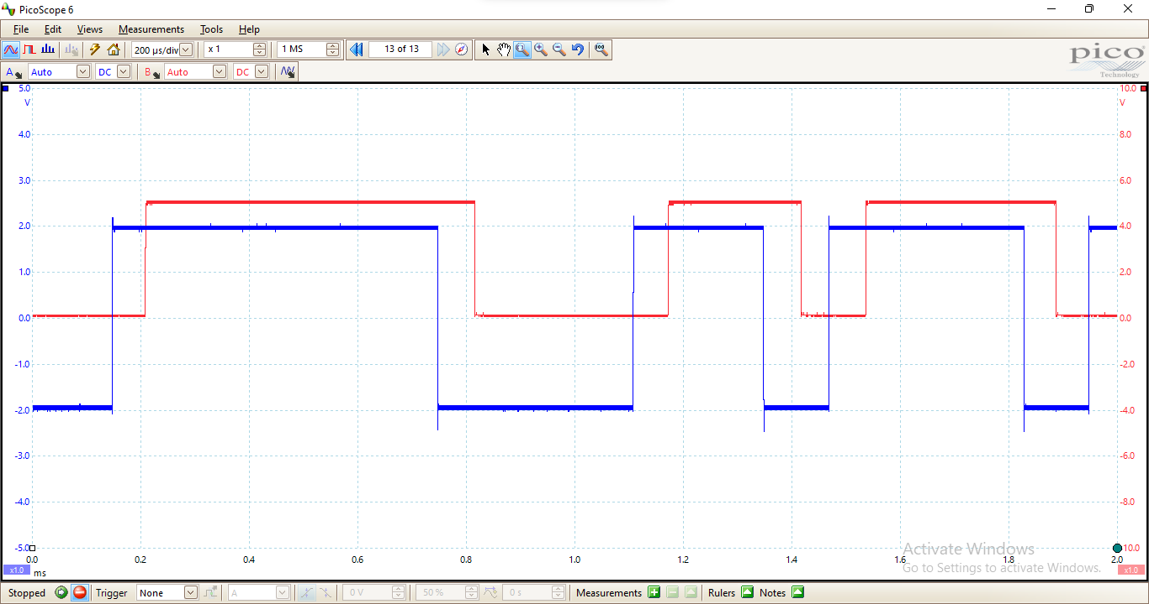
Working Methodology of BPSK
Part D- Adding Noise to Transmitted Signal: Emona Board Implementation and Pico-scope Output
1.-20dB
2.-6dB
Demodulation
3.0dB

Slide 15
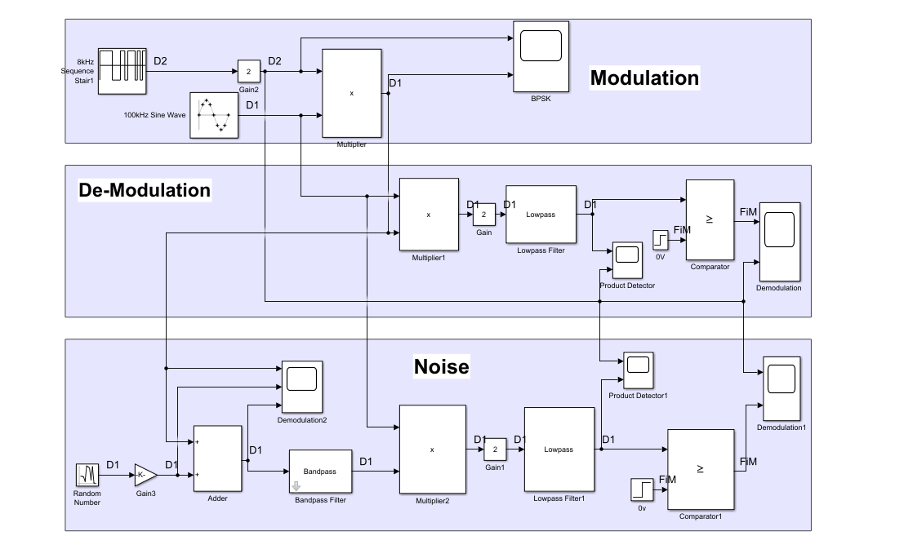
Simulink Schematic

Slide 16
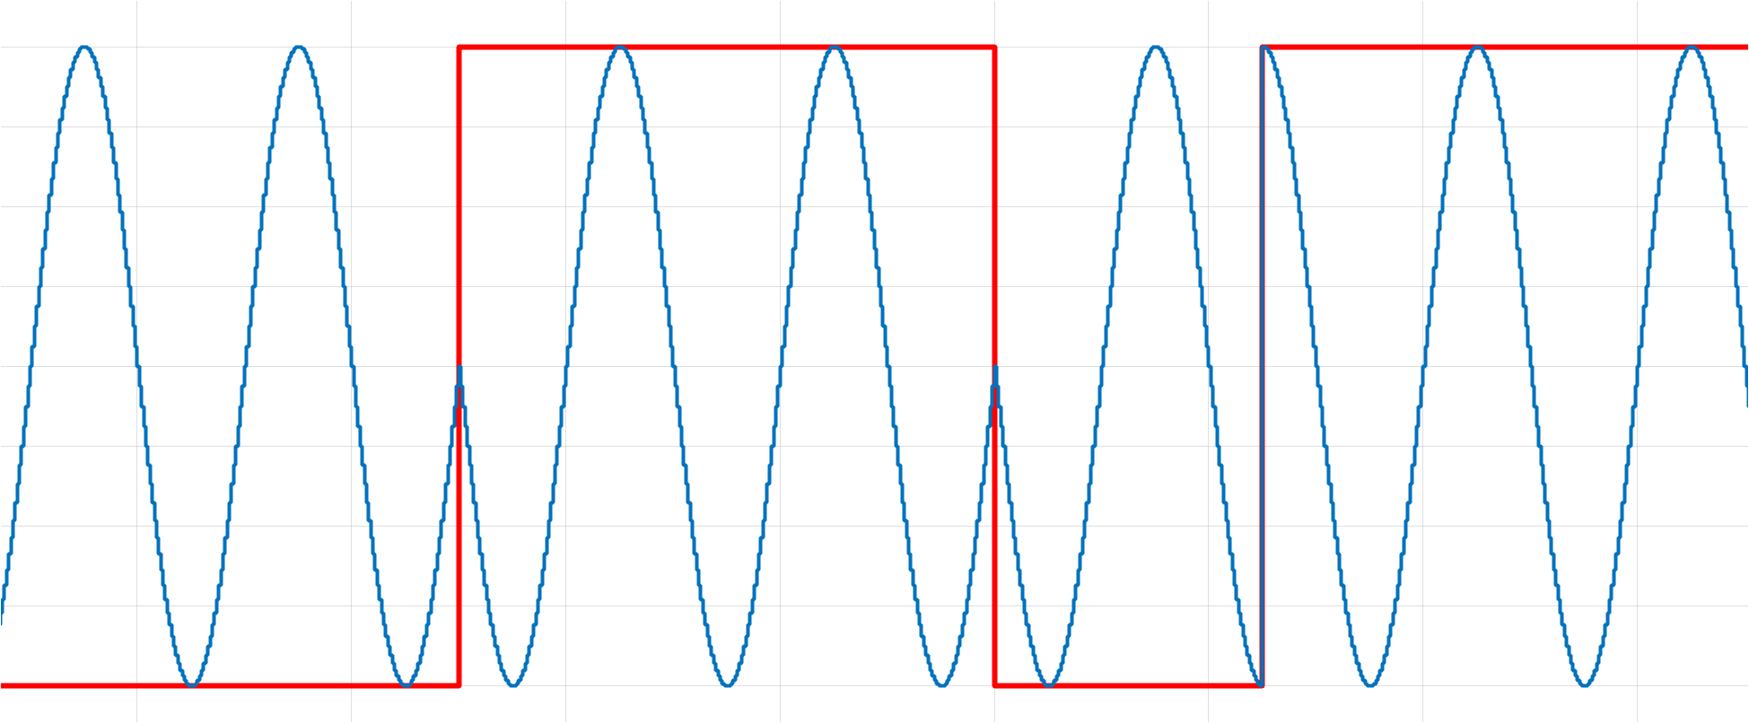
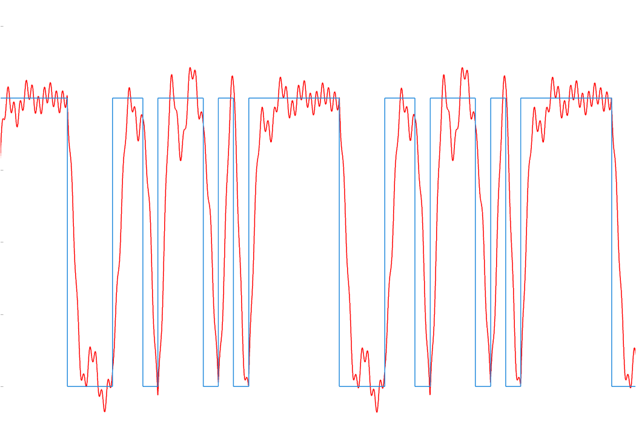
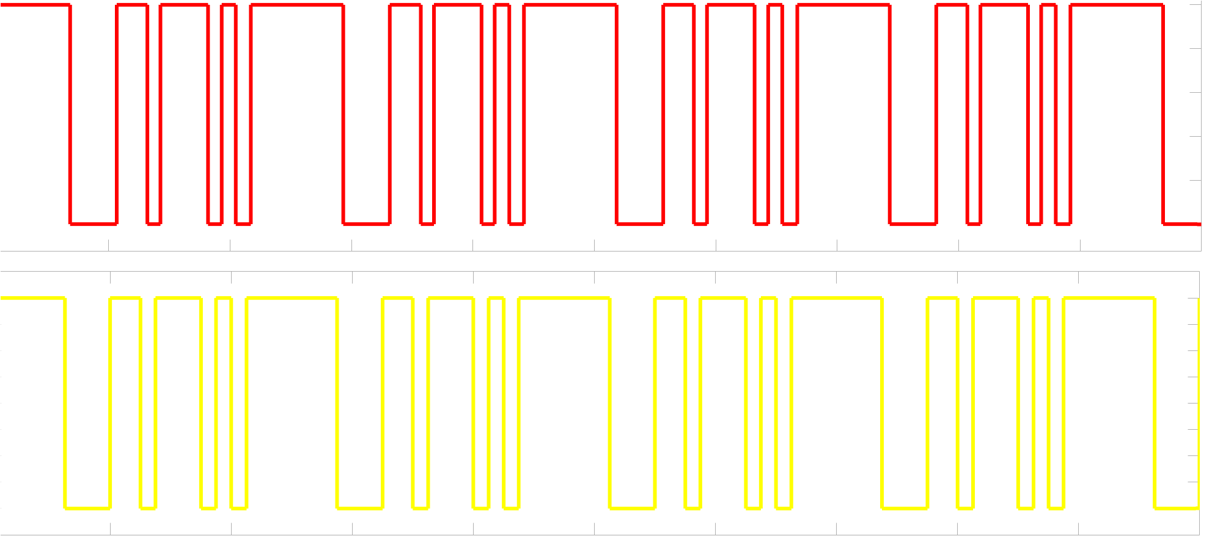
Output From Simulink
Modulation:
LPF Output:
Demodulation:

Slide 17

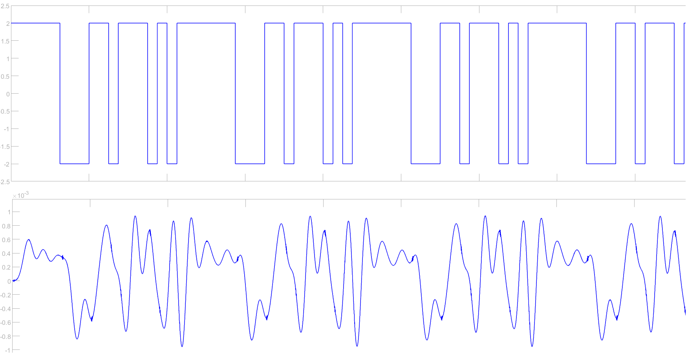

Output From Simulink (With Noise)
Modulation:
LPF Output:
Demodulation:

Slide 18
Compare Between Hardware and Simulink Output
Hardware
Modulation
2. LPF Output
Simulink
Modulation
2. LPF Output

Slide 19
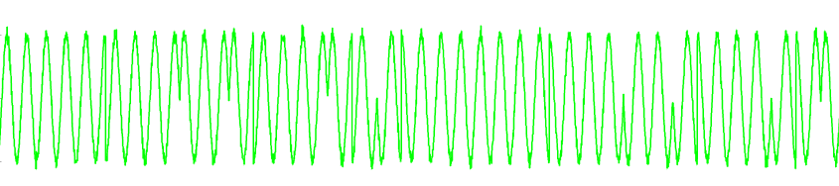
Compare Between Hardware and Simulink Output
3.Modulation
4. Modulation with Noise
5. Demodulation with Noise
3.Modulation
4. Modulation with Noise
5. Demodulation with Noise

Slide 20
Conclusion
The system illustrates the interplay between the modulation, noise, and demodulation stages, highlighting how noise impacts signal quality and how the design mitigates these effects.
The simulation and hardware successfully demonstrated the process of Binary Phase Shift Keying (BPSK) modulation and demodulation.

Slide 21



